Slide 1
Secure File Sharing Using Access Control
Mini Project – Cyber Security & Forensics

Slide 2
01
Problem Statement & Objective

Slide 3
User 1 can select a file from website and enter a key for that file.
For Uploading the File is broken into separate chunks and these chunks are encrypted by AES and DES algorithm respectively.
Then user 1 selects another user with whom he will share the file with.
User 2 receives and SMS with Encrypted key.
User 2 will login using his credentials and request the file.
Application will start the decryption process. For decryption both the encrypted files are decrypted one by one and then merged together.

Slide 4
Objective of the Project
To maintain Integrity & Confidentiality while transferring data over the Internet.
To present an online platform to manage and share files.
To communicate and exchange the important / Confidential files in a more secured way.
End to End Encrypted System

Slide 5
01
Technologies Used

Slide 6
Technologies Used
Python Programming (Backend)
Django Web Framework
SQLite Database
Cryptography Modules
Multithreading (For Chucks Processing)

Slide 7
02
Web Application Setup

Slide 8
Django Implementation
Database Setup (MYSQL)
Authentication System (Password Hashing)
Frontend Setup (Template Setup)
Rest API Deployment (Input Data)
Universally Unique Identifiers (UUID) Setup

Slide 9
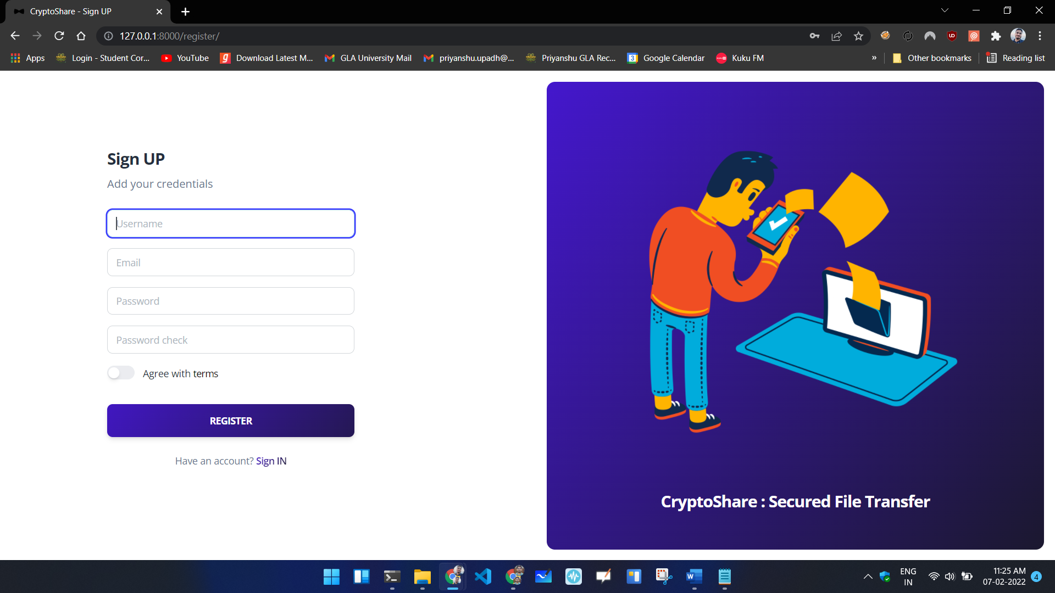

Slide 10
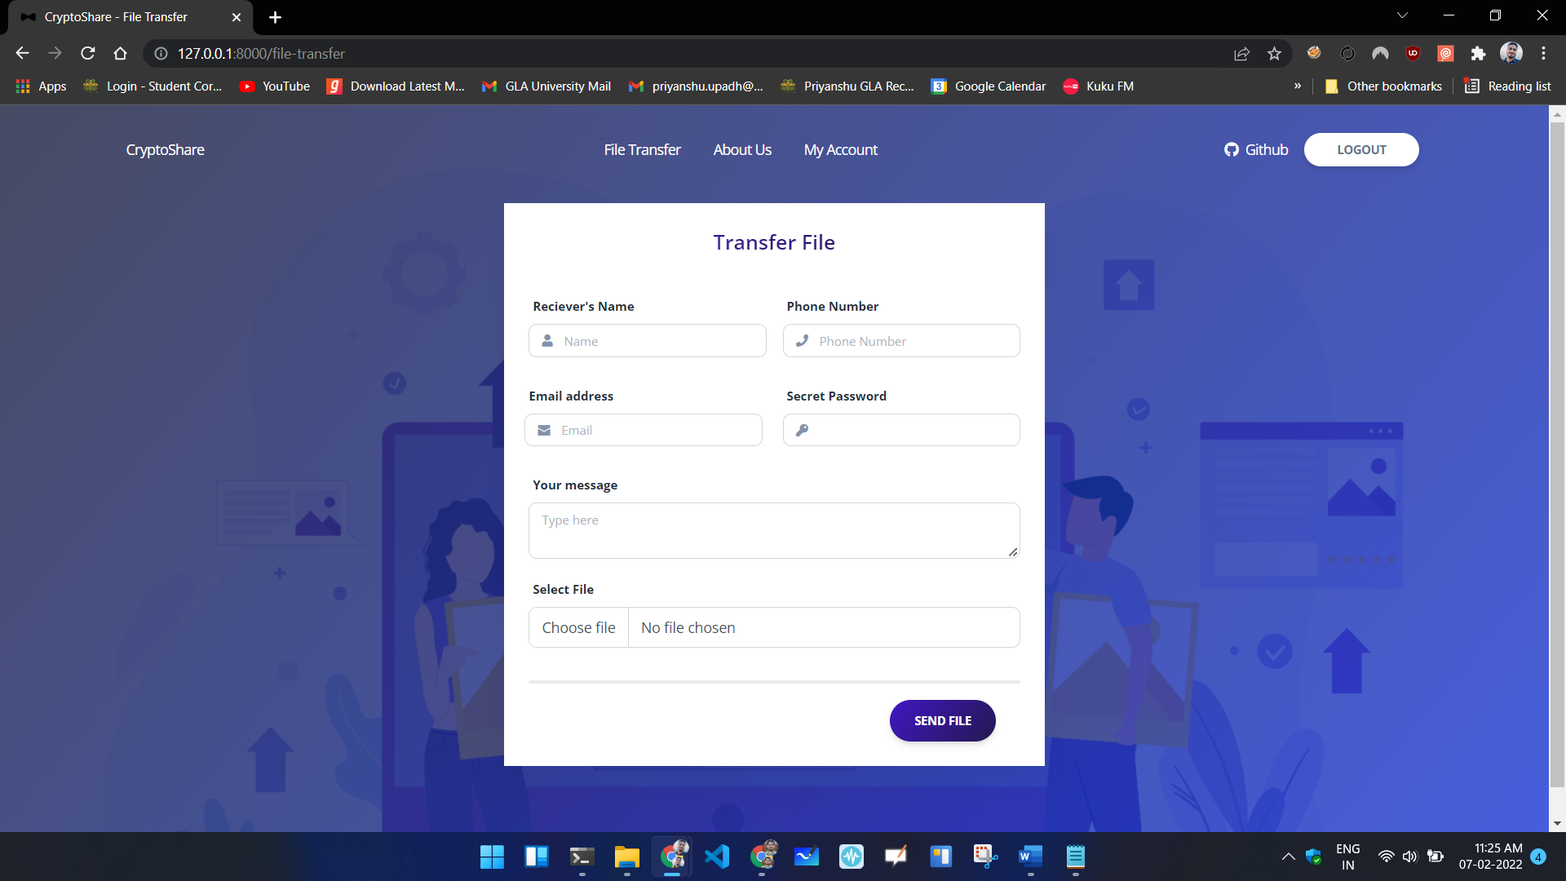

Slide 11
03
Backend Implementation

Slide 12
File Encryption
Accessing File From API
Chunks Division
Chunks Encryption (Based on Odd Even)
Encrypted Chunks Joining
Storing Encrypted File on Server

Slide 13
Chunk Division & Encryption
File
File
Chunk 1
Chunk 2
Chunk 3
Chunk 4
(AES)
(DES)
(AES)
(DES)
Encrypted File

Slide 14
File Decryption
Accessing Encrypted File From Server
Splitting File into Chunks Again
Decrypting Each Chunks (Based on Odd Even)
Joining Decrypted Chunks
Generate Unique File URL Based on UUID

Slide 15
03
AES & DES Encryption

Slide 16
About AES & DES
AES Encryption algorithm is a symmetric block cipher algorithm with a block/chunk size of 128 bits. It converts these individual blocks using keys of 128, 192, and 256 bits. Once it encrypts these blocks, it joins them together to form the ciphertext.
Triple DES is a symmetric key-block cipher which applies the DES cipher in triplicate. It encrypts with the first key (k1), decrypts using the second key (k2), then encrypts with the third key (k3). There is also a two-key variant, where k1 and k3 are the same keys.

Slide 17
04
Multithreading

Slide 18
While Decryption & Encryption of file we are using Multithreading Concept.
It allows for multiple threads to be created within a process, executing independently but concurrently sharing process resources.
Odd Chunks are processed by Thread 1 and Even Chunks are processed by Thread 2.
It helps to reduce runtime.

Slide 19
05
API Implementation

Slide 20
API INTEGRATION
Integrated SMS and email API as a medium for sharing security credentials like secret key & file URL.
Checks security measures such as no rate limiting, Authentication & Authorization etc.
SERVICES USED
Used ClickSend API Service for SMS triggering
Used Gmail SMTP for sending emails. (cryptofiletranfer@gmail.com)

Slide 21
THANKS!

